Slide 1

CS3343 Software Engineering Practice Week 3 Exercises on Test Automation (JUnit)
PokerGame
1

Slide 2
Objective
To install and configure programming environment
Tool: Eclipse and Plugins following the guide
To conduct automate testing on Java programs
Tool: JUnit with Eclipse
To appreciate a Java coverage tool
Tool: EclEmma with Eclipse

Slide 3
Activities
Review the Eclipse Plugin Guide on Project Website
https://canvas.cityu.edu.hk/files/4627565/download?download_frd=1
JUnit Testing
Exercises 1-3: Complete in 30 minutes
Code Coverage Measurement Achieved by Test Cases
Exercise 4: Complete in 20 minutes
Bug Localization (optional)
Exercise 5: Complete in 10 minutes

Slide 4

Case Study – A Simple Poker Game
Background
A player is given a hand, namely 5 distinct poker cards, from a deck of 52 distinct cards
13 cards: A, 2, 3, 4, 5, 6, 7, 8, 9, X, J, Q, and K
(X = 10)
4 suits: club (C), heart (H), spade (S), and diamond (D)
4
Notes:
A full house, also known as a full boat, is a hand such as 3♣ 3♠ 3♦ 6♣ 6♥, that contains three matching cards of one rank and two matching cards of another rank.
Software Design
4

Slide 5

4 Suits
Club (C), Heart (H), diamond (D) and Spade (S)

Slide 6
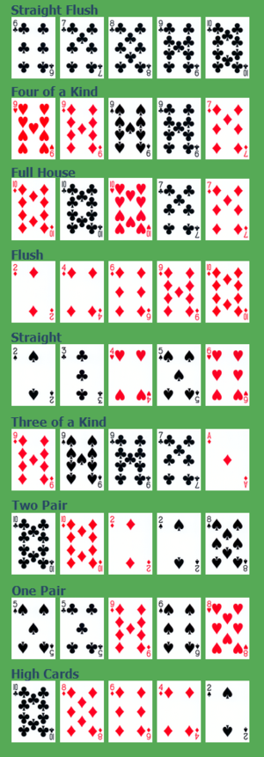
Exercise 1
Study the Java implementation of Poker Game
See the next slide and save the file as “Poker.java”.
Download from Canvas website and Setup the project.
Functional Requirements:
To check whether a hand of 5 cards is a full house
Full house: three cards of one rank accompanied by two of another
How do you implement this function?
6
Notes:
Software Design
6

Slide 7
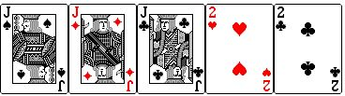
Full House (3+2)
A full house is three of one card, and two of another card. So it can be three eights and two six's, three nines and two fours, or any other combination that you can pull.

Slide 8
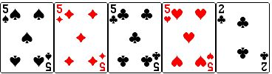
Four of a Kind (4+1)
While four of a kind is incredibly tough to land, it's still possible. You have to get all four of the same card in the deck.

Slide 9
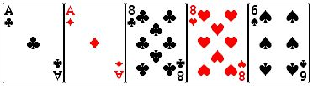
Two Pair (2+2+1)
As you can imagine, it is just having two different pairs.

Slide 10
Poker.java (not “poker.java”!)

Slide 11
Exercise 2
Double-click the text on the right to open the document in Notepad and save a copy as “PokerTest.java”.
Study the JUnit test cases to automate testing the Java implementation of Poker Game.
Do not uncomment the test cases that have been commented out for this exercise.
Further Resources
http://junit.sourceforge.net/javadoc/
11
Notes:
Software Design
11

Slide 12
Specification of 8 Test Cases for “isFullHouse” [don’t guess from the intended functionality of “isFullHouse” to produce the result based on the given input. The program under test can be incorrect]
Test Case | Input | Expected Output | What is the result that you observe from running the test case on the program?
1 | n=0, cards = { } | False
2 | n=5, cards = {“C2”, “D2”, “H2”, “S3”, “S4”} | False
3 | n=5, cards = {“DJ”, “SJ”, “CK”, “DK”, “HK”} | True
4 | n=5, cards = {“C3”, “D3”, “S3”, “HX”, “SX”} | True
5 | n=5, cards = {“C2”, “D2”, “C3”, “D3”, “C4”} | False
6 | n=5, cards = {“CA”, “C2”, “C3”, “C4”, “C5”} | False
7 | n=5, cards = {“C6”, “D6”, “H6”, “S6”, “D7”} | False
8 | n=5, cards = {“CA”, “DX”, “HX”, “SX”, “DK”} | False
12
Notes:
Software Design
12

Slide 13
Exercise 3
Execute the JUnit test cases under Eclipse
Steps
Download the Eclipse: https://www.eclipse.org/downloads/eclipse-packages/
Create a New project called “PokerGame” with the following tricks and existing code [See next slide]:
Java implementation of Poker Game: Poker.java (for Exercise 1)
JUnit test cases: PokerTest.java (for Exercise 2)
(Add a “JUnit 5” library to the project (if it has not shown)
Steps: Right-click your project → Properties → Java Build Path → Libraries → Classpath → Add Library… → JUnit → JUnit 5 → OK → OK)
Our Eclipse should have enabled it.
Perform a JUnit test run
13
Notes:
Software Design
13

Slide 14
Some Tricks for Step 2 of Exercise 3
2a: We may firstly create the packages “poker” and “testcase”.
2b: We then right click the “poker” package, select “Import”, select “General/File System”, locate the file “Poker.java”, and import it. Now, you can see that this java file is under the poker package in the Package Explorer.
2c: Do the same to import “PokerTest.java” into the package “testcase”.
14
Notes:
Software Design
14

Slide 15
Exercise 4
Operate EclEmma: steps
Setup EclEmma for Eclipse
Follow Option 2 at http://www.eclemma.org/installation.html
Right click your project, then select “Coverage As” and run JUnit Test.
If you cannot find “Coverage As”, then select Run->Run Configurations->Junit->Common, and then select “Coverage”.
Show Coverage
In Coverage explorer, choose column to display.
Green = executed statements
Red = the statements that the test cases have not executed.
Uncomment the test cases 3-6 in PokerTest.java, and try again.
Uncomment all test cases 3-8 in PokerTest.java, and try again.
15
Notes:
Software Design
15

Slide 16
Exercise 5: What to Do Next?
In Test-driven development, a programmer should firstly write a set of test cases to enumerate what the programmer want to the program (to be developed) to output for the input specified in the test cases. As the program has not been developed, all test cases will be failed initially. However, as more code is developed, the set of test cases will gradually change from failed to passed.
Strategy 1: Testers develops the test cases to ensure that the program to be developed by programmers is not “too bad”.
Strategy 2: Add test cases whenever the programmer finds some cases not covered by the existing test cases to protect the programmer from making implementation mistakes.

